Slide 1

Netw191 Final project deliverable
By charles Purnell

Slide 2
THINGS THAT I’VE LEARNED FROM THIS COURSE
1. Computer networking: computer networking refers to connecting two or more computers to share files or other resources. Computers can be connected either by wires or wirelessly (i.e. through WiFi). Once computers are connected, they can communicate in many useful ways that are essential for everyday life⁠
2. LAN (local area network): a LAN connects computers over shorter distances or smaller areas, such as a school or office building. A LAN tends to be less expensive because it is built from cheaper hardware like ethernet cables, and also provides higher security and speed
3. WAN (wide area network): a WAN connects computers over wider distances, like from state to state or continent to continent⁠. In fact, the internet is the largest WAN and connects billions of computers worldwide!

Slide 3
Project 2

Slide 4
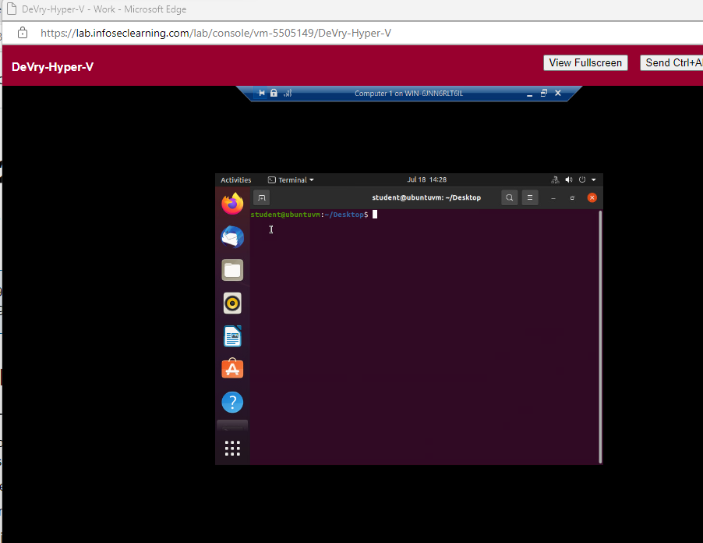
Preparation
This screenshot should include the terminal window that shows the default gateway IP address.

Slide 5
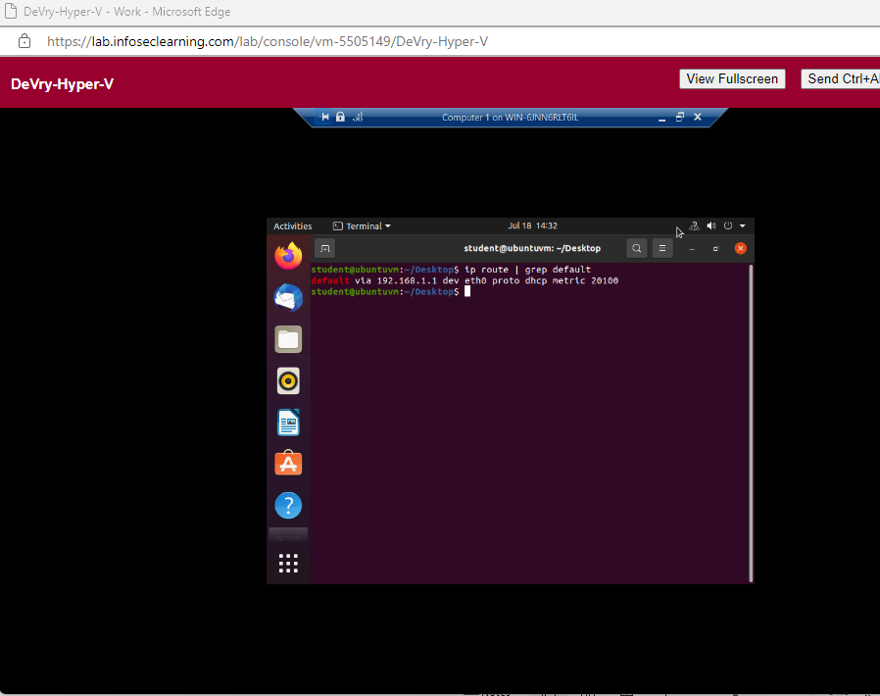
IPv4 Address Assignment
This screenshot should include the Interfaces page that shows the new IPv4 address on the LAN interface.

Slide 6
Project 3

Slide 7
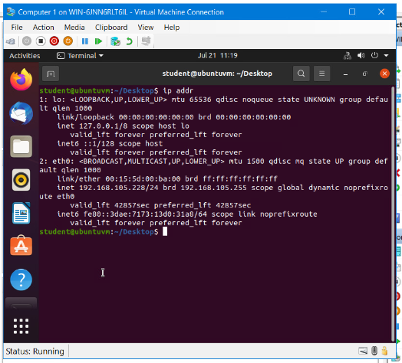
Dynamic IP Address Assignment
This screenshot should show the IPv4 address of the Computer 1 VM.

Slide 8
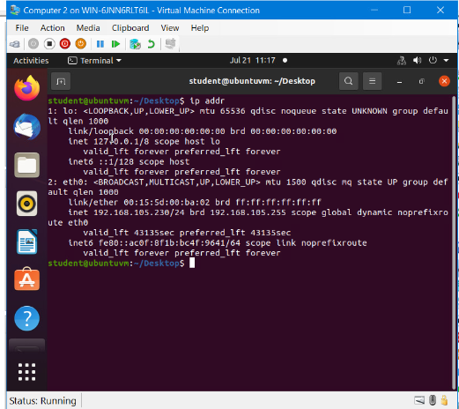
Dynamic IP Address Assignment
This screenshot should show the IPv4 address of the Computer 2 VM.

Slide 9
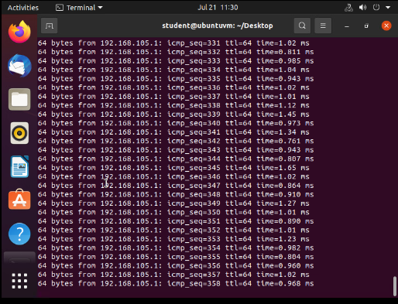
Connectivity Test
This screenshot should show the connectivity tests between the Computer 1 VM and the other two devices (i.e., the SOHO Router VM and Computer 2 VM).

Slide 10
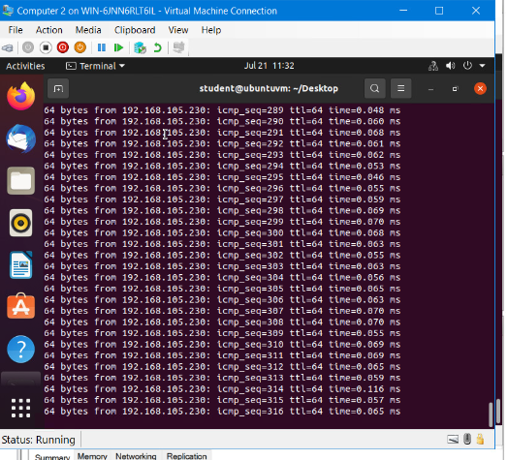
Connectivity Test
This screenshot should show the connectivity tests between the Computer 2 VM and the other two devices (i.e., the SOHO Router VM and Computer 1 VM).

Slide 11
Project 4

Slide 12
Subnetting Table
Subnet | Subnet Notation | Network Address | First Usable Host Address | Last Useable Host Address | Broadcast Address
The First Subnet | 192.168.5.0/25 | 192.168.5.0 | 192.168.5.1 | 192.168.5.126 | 192.168.5.127
The Second Subnet | 192.168.5.128/25 | 192.168.5.128 | 192.168.5.129 | 192.168.5.254 | 192.168.5.255
This table should include two /25 subnets, listing the subnet notation, network address, first usable host address, last usable host address, and broadcast address of each subnet.

Slide 13
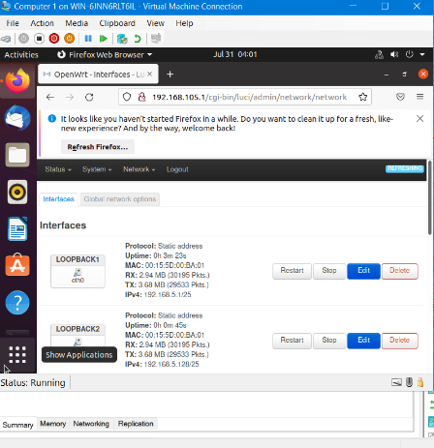
Loopback Interfaces
This screenshot should show both Loopback1 and Loopback2 interfaces and their correct IPv4 addresses.

Slide 14
Project 5

Slide 15
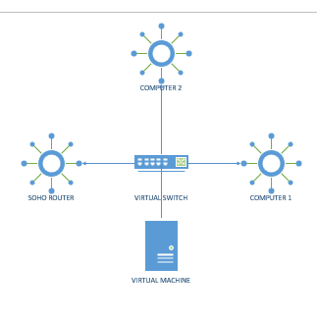
Microsoft Visio Network Diagram
This diagram should illustrate the interconnection of the Computer 1 VM, the Computer 2 VM, and the SOHO Router VM.

Slide 16
Project 6

Slide 17
SOHO Wireless Network Security
1. What are the factory default username and password of a TP-Link router? Why is it important to change the default username and password of a SOHO router?
Answer:
Admin all lowercase
To prevent improper data transmission encryption
2. To protect a SOHO wireless network with a small number of devices, which address management method provides more control, configuring the device IP addresses manually (static IP) or using a DHCP server (dynamic IP)? Why?
Answer:
One way to limit who could have access to a wireless network is by filtering out devices based on their physical hardware addresses. These addresses are burned into the devices when they’re manufactured. These are called media access control addresses, or MAC addresses, and it allows you to create a list of filtered addresses for your network.
3. What does MAC filtering do? If needed, when would you use deny filtering rules and when would you use allow filtering rules? What happens to devices that want to connect, if the “Allow the stations specified by any enabled entries in the list to access” function is enabled but there are no entries in the list?
Answer:
In computer networking, MAC Filtering refers to a security access control method whereby the MAC address assigned to each network card is used to determine access to the network.
One of the thumb rules of permission is: Deny access always overrides Allow access. This means, if an object is member of multiple allow groups but at least one deny group, effective access would be deny. Allow the stations specified by any enabled entries in the list to access as the filtering rule

Slide 18
SOHO Wireless Network Security
1. What wireless security settings are displayed on the Wireless Security page? Which one is recommended by the vendor? Why?
Answer: On the Security tab, the default settings for Authentication Mode, Max Authentication Failures, and Cache user information for subsequent connections to this network are sufficient for typical wireless deployments. The settings for both Authentication and Encryption must match the settings configured on your wireless AP
2. Among the configurations you explored in this module, which one is a true security function? Why?
Answer:
Configuration Manager
3. What would you do to protect your wireless network at home? Why?
Answer:
Make my wireless network password unique and strong
Change the default name of your home Wi-Fi
Turn off network name broadcasting

Slide 19
References
1. Internet
2. Class videos
3. Assignment instructions
…

